Slide 1
AUTOHUB
Cruz
Federico
Francis
Luces
Simon
An Assessment of its IS Department

Slide 2
Company Overview
What the company does
automotive dealerships and distributorship
14 years in business
History
initially a car dealership under Ford Dealer
kept expanding its territory
expanded to motorcycles and car distributorship
Branches
The Fort, Davao, Quezon Avenue, Greenhills, etc.
Partners:
Nissan, Hyundai, Rolls-Royce

Slide 3
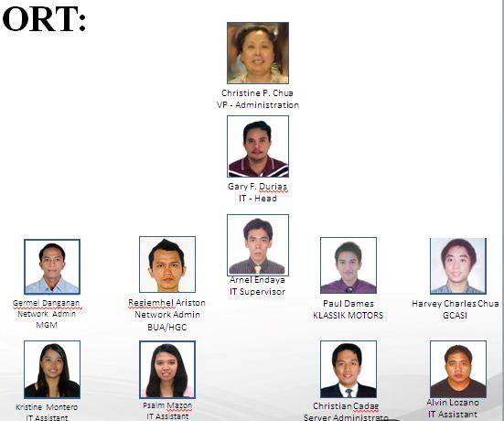
Company Overview: ISD Dept

Slide 4
The Project
Scope
Investigating the data center structure management
Investigating network administration
Determining weakness and strength
List of recommendations
Limitations
Specific hardware details
Protocols and methods deemed as confidential
Physical access to the data center

Slide 5
The Project
Objectives
To determine if the company is able to accommodate all clients in an effective and efficient manner given their current data center setup
To determine if the network setup is effective in its transmission and protection of its technologies
To determine the company’s strengths and weaknesses in reference to their network and data center setup
To provide proper recommendations that would improve the IT Department

Slide 6
The Project
Methodology
Interview with IT supervisor and site visit
Internet research

Slide 7
Current Situation:
Data Center
The Data Center:
Location – in Ford Autohub
Arrangement – Two rooms
Components – Cabinet-mounted, UPS, Servers, Batteries, Switches, UTM9 Firewall
Security – Physical (Lock and key, CCTV)
Storage - SAN
Backup – Redundant servers, Offsite Tapes, GFS Scheme (twice a day)
Topology

Slide 8
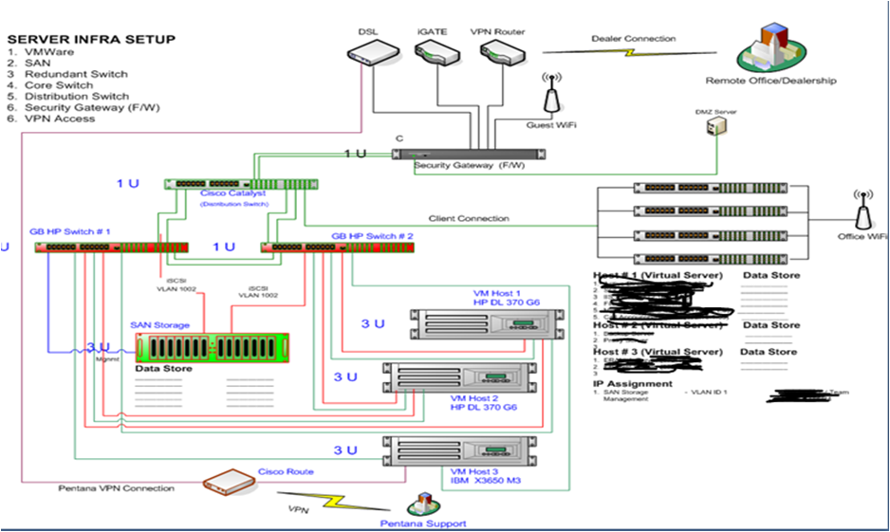

Slide 9
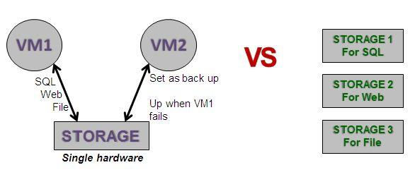
Data Center: Storage
Virtual Storage: Application which enable to expand the storage virtually while utilizing less physical storage

Slide 10
Problem History
Downed Server
Failed Maintenance

Slide 11
Current Situation:
Network
The Network:
Topology
Hardware
Security
Configuration Management
User Management
Software Management

Slide 12
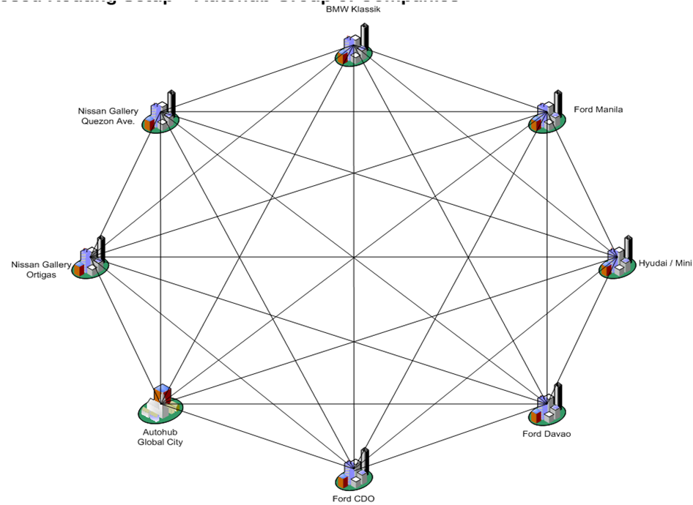

Slide 13
Current Situation:
Network
DSL
IGATE
VP ROUTER – Connection of host site and remote site
FIREWALL – Security
CORE SWITCH
DISTRIBUTION SWITCH
SERVER
HARDWARE
POWER BACK UPS

Slide 14
Current Situation: Network
Network Administrator:
Web Monitoring – What sites? Duration of access? User?
Security Monitoring – Hackers and viruses
Web Filtering – What can an account/user access?
Network Utilization – Capacity of usage
Live Monitoring – Real time monitoring

Slide 15
Analysis: Network
Mesh Topology
Pros:
-Good for geographically dispersed sites
-Extensibility
-Sites don’t get affected if one site fails
Cons:
-High costs
-Difficult implementation and maintenance
Leads to compromisation

Slide 16
Analysis: Network
UTM 9
Pros:
-Simple
-Comprehensive security (From firewall, mail system, endpoint antivirus, etc.)
-Ease of Use through interface
-Built-in reporting mechanism
-Web filtering
-Provides level-7 security
-Secure remote access (VPN)
-Web server protection
Cons:
-High costs
-Difficult implementation and maintenance
-Can be slow if there is a lot of processes

Slide 17
Analysis:
Configuration and Software Management
Pros:
1. Centralized configuration and application management
Ease of management and maintenance
2. Data loss prevention
Cons:
Overlooked some processes
Risky
Does not vie for sustainability
Lacks separation of duties
Lacks proper documentation

Slide 18
Analysis: User Management
Use of Active Directory
Remotely provides limited access
Minimal Exposure
Minimal Privilege
Comprehensive password protocols

Slide 19
Analysis: Data Center
Pros:
Redundant Parts
SAN
Automatic Notification
Virtualization
Cons:
Lack of Planning
Space Constraint
Expansion and Crowding
Security

Slide 20
Analysis: Summary
Criteria | Network | Data center
Chance of failure | Low | Low
Recovery time | Medium | Medium
Chance of infiltration | Medium | Medium
Potential for expansion/upgrade | Medium | High
Cost incurred during failure | High | Medium
Flexibility | High | Medium

Slide 21
Recommendations:
Data Center
A 3-year plan for the future of the data computing needs of Autohub.
Addition of IT Solutions/ Professional
Provisions made for continuous operations during data center renovation
Complete refurbishing of current data center space to rid it of unnecessary cables, hardware, etc.
Addition of further data center utilities such as a fire suppression system and structured cabling
Upgrading of current physical access controls to the data center.
Proper data center and infrastructure management
Disaster and recovery (DRP)

Slide 22
Recommendations: Network
Set up policies for documentation
Clarify separation of duties
Hire additional employees that would focus on specific areas and roles.
ex. Monitoring Specialist (for server, storage, network, etc)
Establish a knowledge management system
proper and efficient information handling and sharing
Improve virus and intrusion detection by setting up better systems and software
Improve monitoring protocol and maintenance by increasing frequency
Add additional ISP for backup purposes.

Slide 23
References
"Storage Area Network(SAN) - Articles, Overviews and Web Resources." Storage Area Network(SAN) - Articles, Overviews and Web Resources. N.p., n.d. Web. 07 Oct. 2013.
Wikipedia contributors. "Unified threat management." Wikipedia, The Free Encyclopedia. Wikipedia, The Free Encyclopedia, 3 Oct. 2013. Web. 7 Oct. 2013.
Sparrow, Penna. "Mesh Topology: Advantages and Disadvantages." Mesh Topology: Advantages and Disadvantages. Ianswer4u, n.d. Web. 07 Oct. 2013

Slide 24
Appendix: ISD Dept
Goals:
Provide IT Support and Services
Technology Modernization
Computerization and Automation
Reduce IT operating expenses

Slide 25
Appendix: ISD Dept
Components
Technical Support
First level of support
Day to day concerns of users whether systems, network, and/or server
Requires basic knowledge in IT
Systems and Application Support
System specific knowledge (INCADIA, DMIS, DMS)
Network Support
Security of network issues, equipments, transaction
Server Administration and Support
Both system and hardware regardless the server (ex. web server, file server, database server

Slide 26
Appendix: ISD Dept
Roles and Functions:
Provide Technical Support
Maintain and Administer IT Services
Network and Security Administration
Technology Update and Modernization

Slide 27
Appendix- Server Admin Services
•Domain Controller – Manages accounts/users. The access granted to the account
•File Server – Manages storage per department. Communicates with domain controller on what files it should manage
•Mail Server – Monitoring of emails. Processed and rejected
•Database Server – Database monitoring and administration
•Application – Does not run without the database. Ex. HRIS Helpdesk, website hosting
•Back Up System – Manual backup performed daily
•Disaster Recovery – Forces of nature (not employed yet)
•Telephone System – Local area landlines.

